Slide 1

The Generation and Use of TLS Fingerprints
Blake Anderson, PhD; David McGrew, PhD; Keith Schomburg
Cisco

Slide 2






Reducing the Visibility Gap
?
?
VM

Slide 3
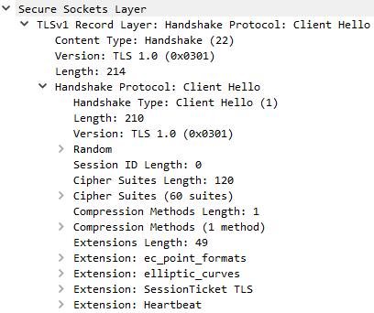
TLS Fingerprinting Overview
TLS parameters offered in the ClientHello can provide library/process attribution [1-6]
Applications
Network forensics
Malware detection [2]
Identifying obsolete/vulnerable software
OS fingerprinting [3]
Advantages
No endpoint agent required
Completely passive

Slide 4
Fingerprinting Goals
Efficacy
Flexibility
Compatibility
Maximize discerning power by including all informative data features
Reversibility
Performance
Enable approximate matching where needed
Accommodate missing data and new protocol features
Fingerprint format is interpretable and forensically sound
Fast and compact extraction and matching

Slide 5
Network and Endpoint Data Fusion
Problem: Current fingerprint databases are slow to update and lack real-world, contextual data.
Solution: Continuously and automatically fuse network and endpoint data.
Long-Term
Storage
Network Data
?
?
Endpoint Data
VM

Slide 6
TLS Feature Extraction and Pre-Processing
Cipher Suites
Generalize GREASE cipher suites: 0x0a0a,...,0xfafa -> GREASE
Extensions
Generalize GREASE extension types/data
0x0a0a,...,0xfafa -> GREASE
Remove session specific extension data
server_name, padding, session_ticket
Identify
Protocol
Parse
Packet
Extract
Data
Normalize
Data

Slide 7
Comparison with Previous Work
 | Database Size | Automatically Updated | GREASE Support | Static Extension Data
Our Work | ~1,500 | Yes | Yes | supported_groups ec_point_formats​ status_request signature_algorithms application_layer_ protocol_negotiation supported_versions psk_key_exchange_modes
Kotzias et al. [4] | ~1,684 | No | Discards Locality | supported_groups ec_point_formats
JA3 [5] | 158 | No | Discards All Data | supported_groups ec_point_formats
FingerprinTLS [6] | 409 | No | No | supported_groups ec_point_formats signature_algorithms

Slide 8
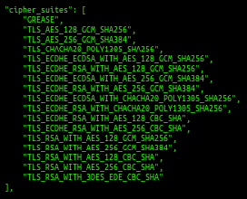
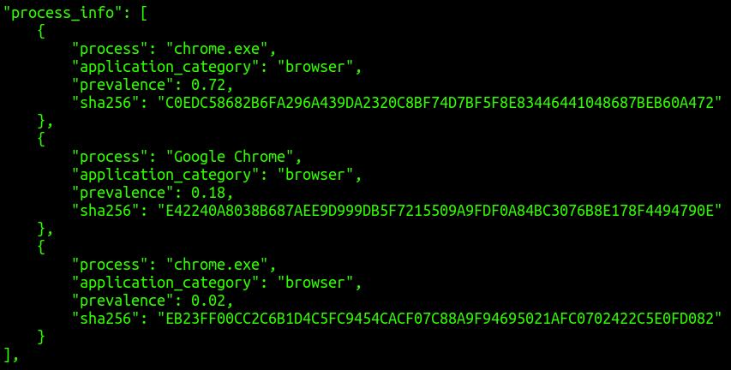
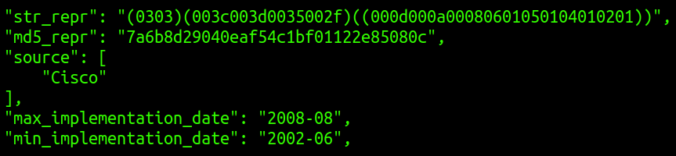
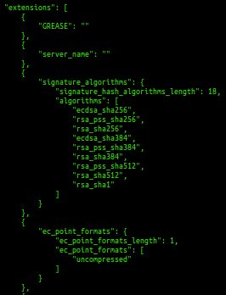
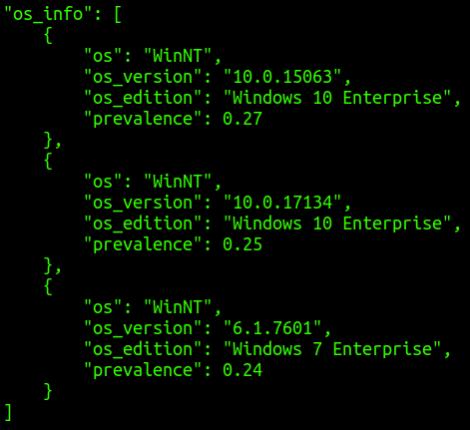
TLS Fingerprint Database Schema
Metadata
TLS Information
Attribution

Slide 9
TLS Fingerprint Database Schema
Metadata
TLS Information
Attribution

Slide 10
TLS Fingerprint Database Schema
Metadata
TLS Information
Attribution

Slide 11
General Stats
Generated from 30M+ real-world TLS sessions
1,567 fingerprints
454 unique cipher suite vectors
1,092 unique cipher suite + extension type vectors
12,644 unique process hashes
2,411 unique process names

Slide 12
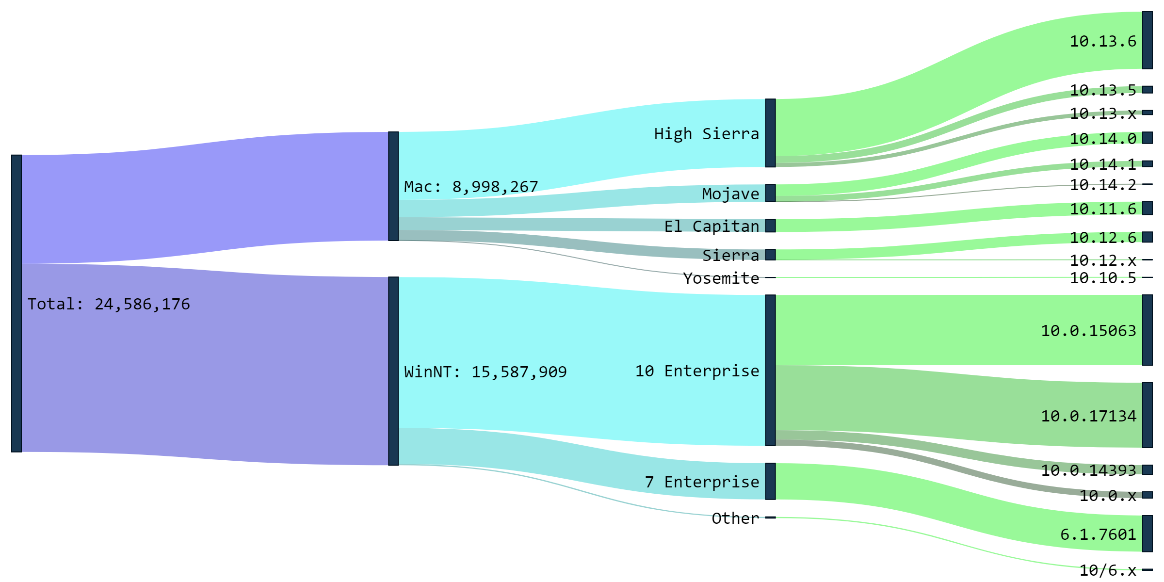
Operating System Representation

Slide 13
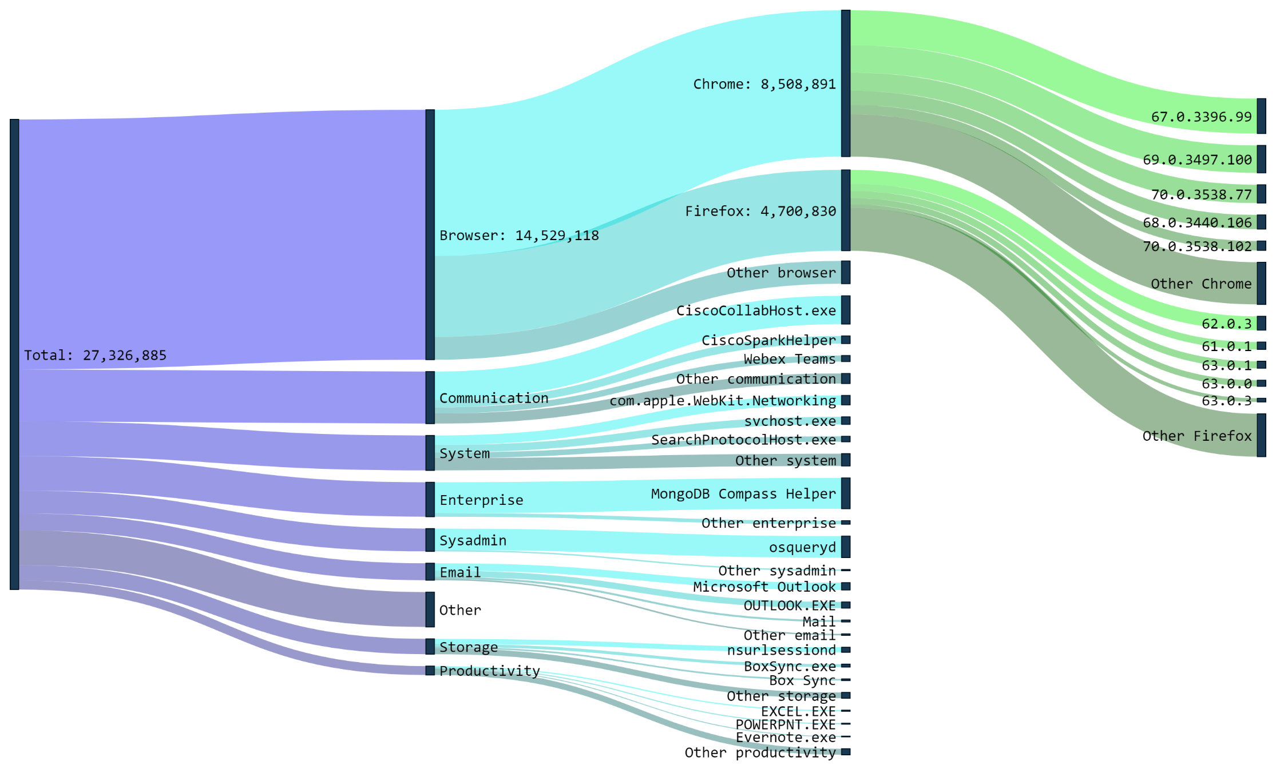
Application Representation

Slide 14
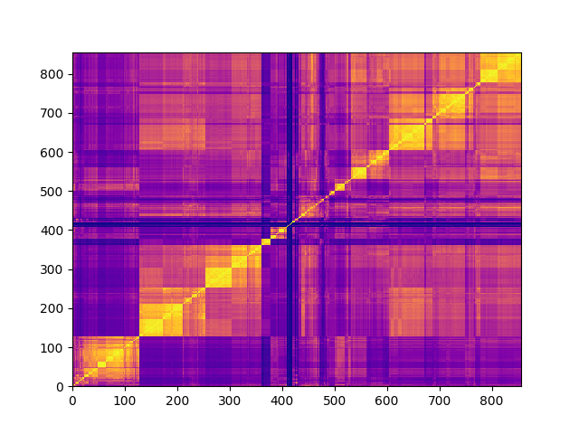
Similarity Matrix
Schannel
Secure Transport
Cisco Collab
Python
Java
Chrome
Firefox
OpenSSL

Slide 15
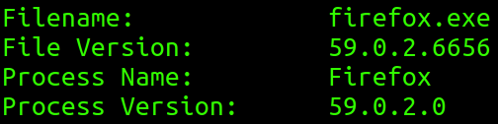
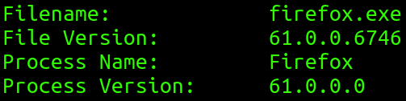
Approximate TLS Fingerprinting
String alignment over TLS features
True Label
Inferred Label
Alignment

Slide 16
Fingerprint Matching Overview
FP
Database
Update Database with
Approximate Match
Identify
TLS
Extract
FP Data
Find Match
Find
Approximate
Match
False
True
Report
Match
Data Plane
Control Plane

Slide 17
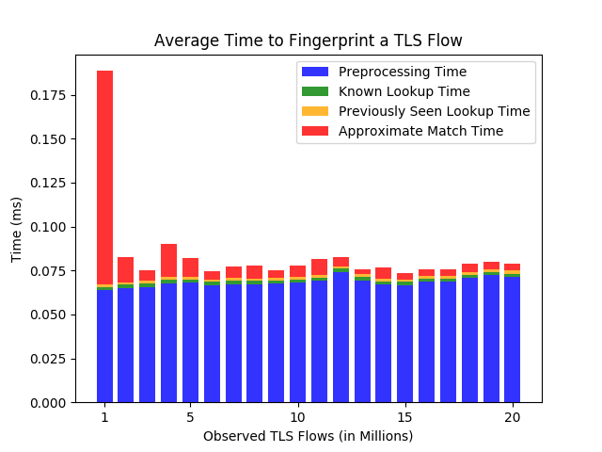
Performance (Unoptimized Python)

Slide 18
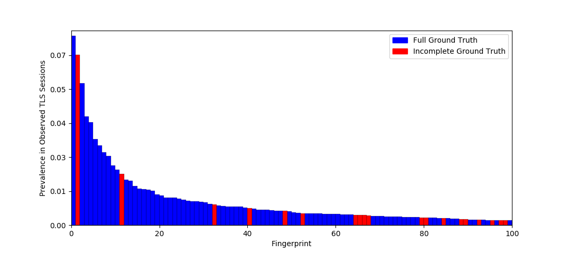
Fingerprint Prevalence

Slide 19
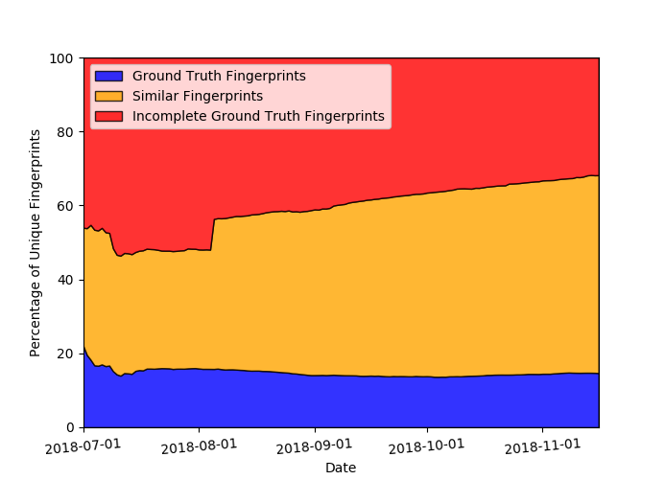
TLS Fingerprint Visibility

Slide 20
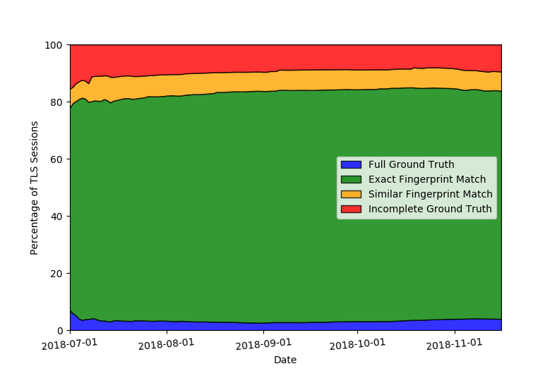
TLS Session Visibility

Slide 21
Implementation
Fingerprint database and relevant code has been open-sourced:
https://github.com/cisco/joy
Joy
Packet parsing and fingerprint extraction
Python Scripts
Exact and approximate matching
Generation of custom fingerprint database from Joy output

Slide 22
Next Steps
More data!
iOS, Android, and Linux
Incorporate other fingerprint databases
Time window analysis

Slide 23
References
[1] https://github.com/cisco/joy
[2] Blake Anderson, Subharthi Paul, David McGrew; Deciphering Malware’s Use of TLS (without Decryption); arxiv, 2016; Journal of Computer Virology and Hacking Techniques, 2017.
[3] Blake Anderson, David McGrew; OS Fingerprinting: New Techniques and a Study of Information Gain and Obfuscation; IEEE CNS 2017, https://arxiv.org/abs/1706.08003
[4] Platon Kotzias, Abbas Razaghpanah, Johanna Amann, Kenneth G. Paterson, Narseo Vallina-Rodriguez, Juan Caballero; Coming of Age: A Longitudinal Study of TLS Deployment; IMC, 2018
[5] John B. Althouse, Jeff Atkinson, Josh Atkins; JA3 – A Method for Profiling SSL/TLS Clients
[6] Lee Brotherston; FingerprinTLS

Slide 24
Thank You

